Slide 1
Relevant Files
-Github Repository
-Local webserver for kicad and other documents will be provided today at presentation on hotspot
WifiSSID: HHTalks PW: Zetier1234
Website:
-Demonseed
-Kicad (also available on server located on HH_TCS2023 for windows and mac. IP and file addr will be provided)

Slide 2

Hardware Hacking on a budget:
Reverse Engineering hardware tools
Conrad Franke

Slide 3
Agenda
1) Background and inspiration
2) Basics of electronics and components and how tools are made
3) Basics of kicad
4) Basics of reverse engineering for electronic components (use a multimeter to build out schematic, making a pcb and gbr files in kicad)
5) Returning the product after usage and ensuring the fabbed out tool works
6) How to fabricate a PCB/DEMO
7) Summary

Slide 4
Background about me
-Small town in northern Michigan
-Sent to Texas military school due to poor life decisions at a young age
-Started learning more about cyber and physics in high school
-Became reverse engineer
-Started to develop my own tools

Slide 5
I need Hardware
-Price was an issue
-Knowledge of tools were of concern
-Time … who needs that?!?! (was super bored)
-Gained skills of EE, RE, and forward development processes in circuitry
-Can fabricate any PCB and electrical circuit I want when I need it

Slide 6
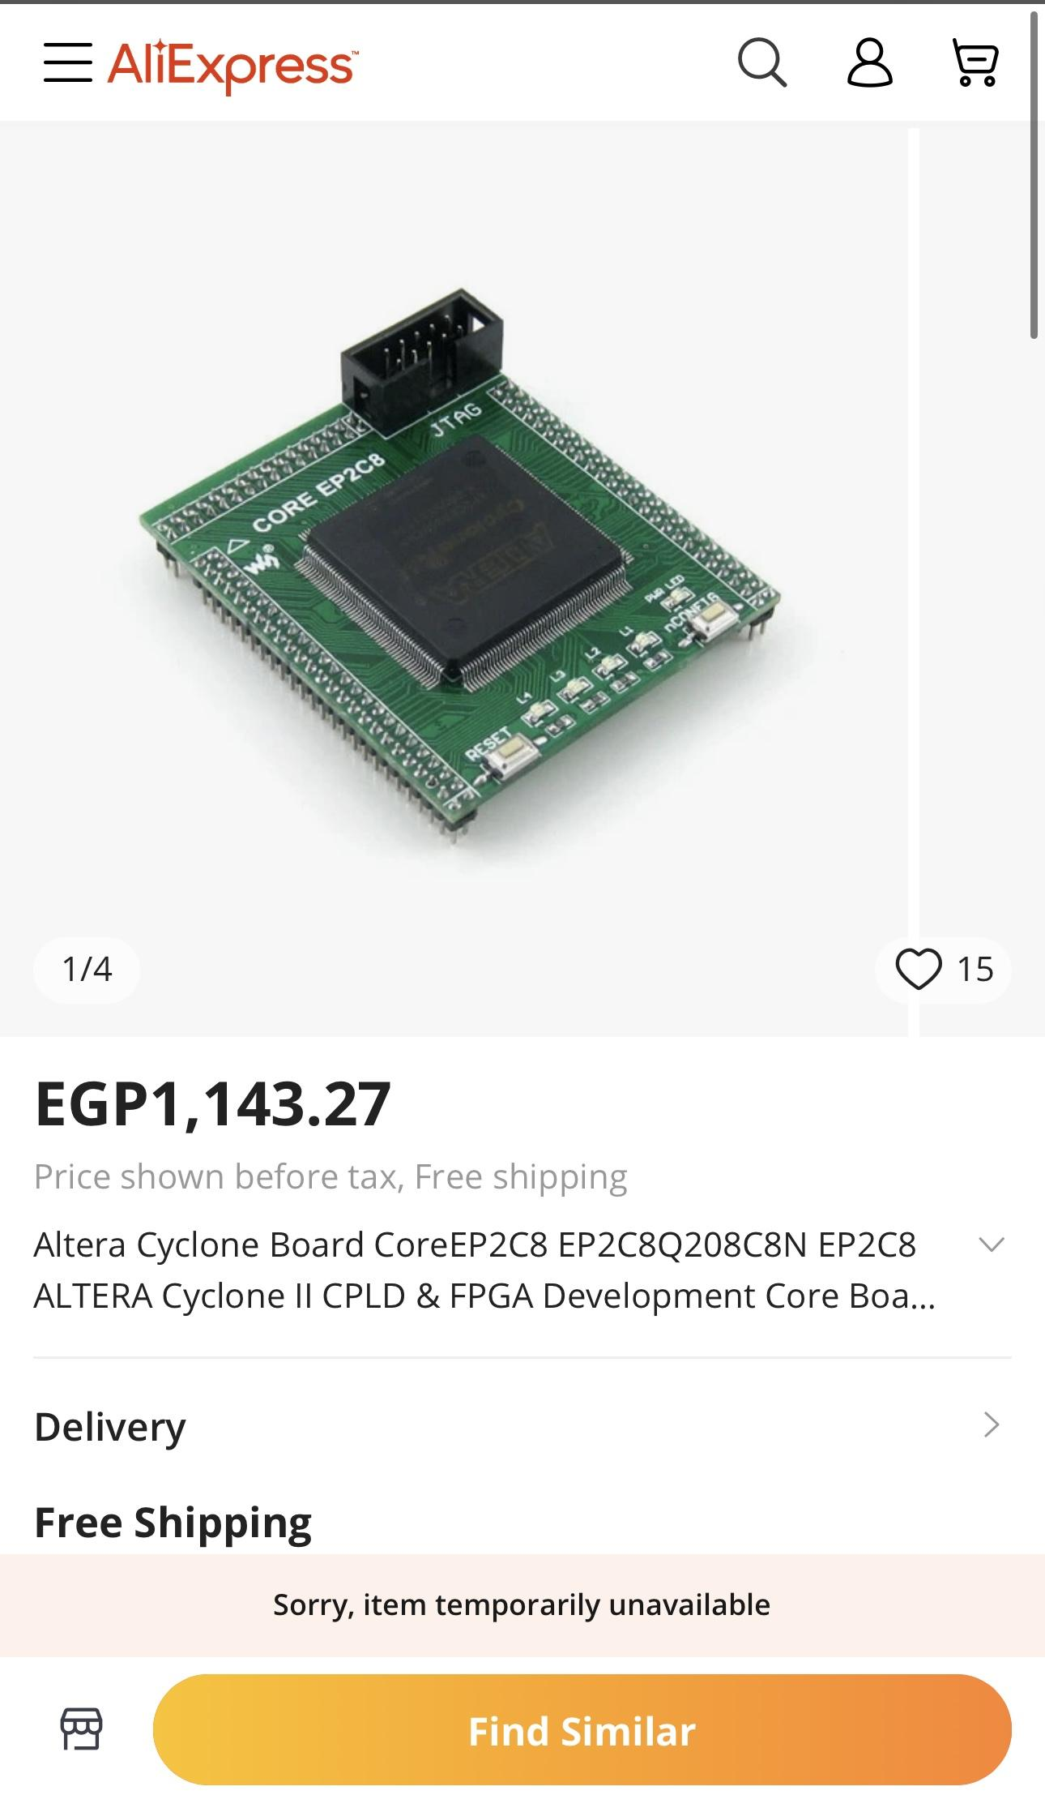
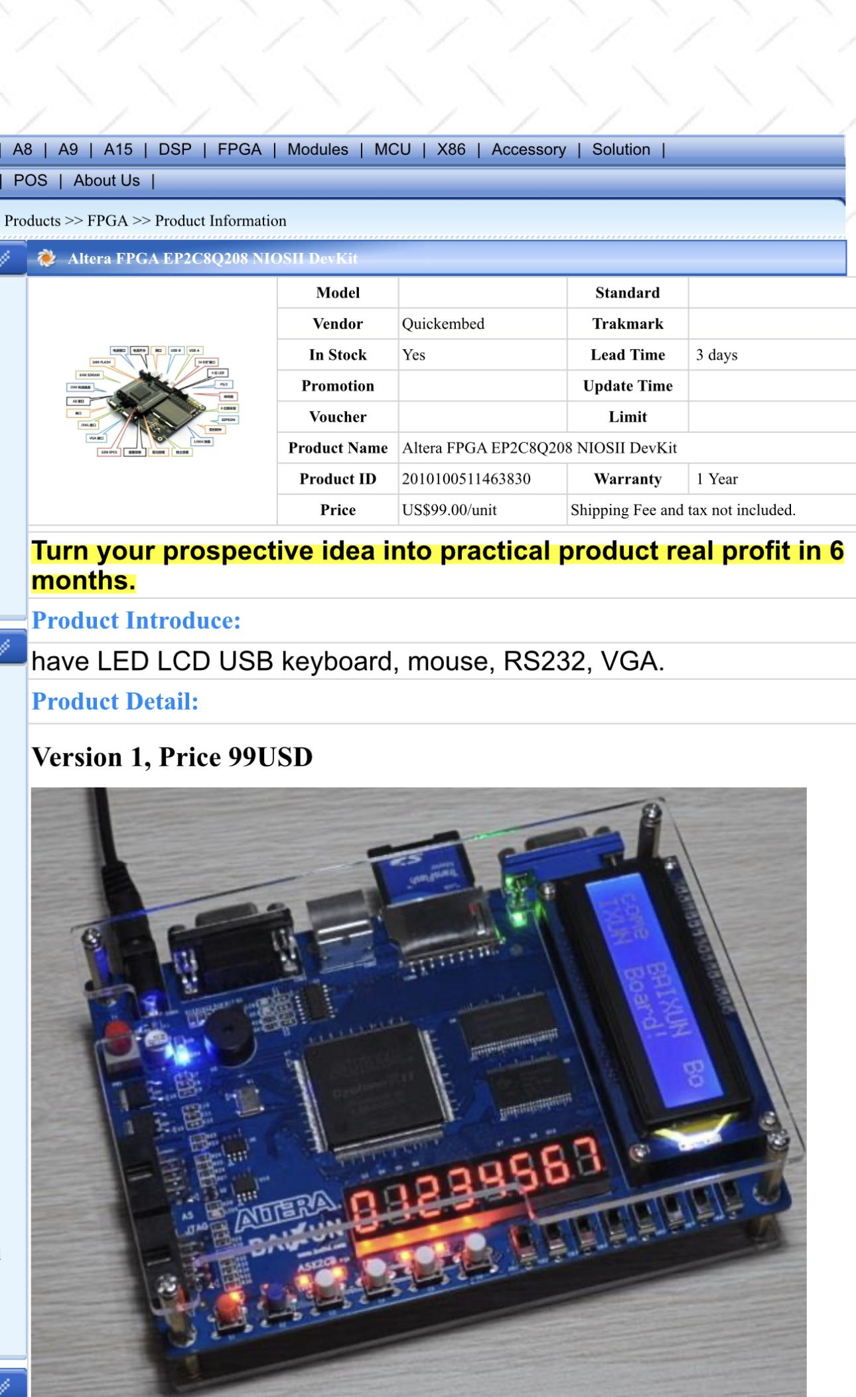
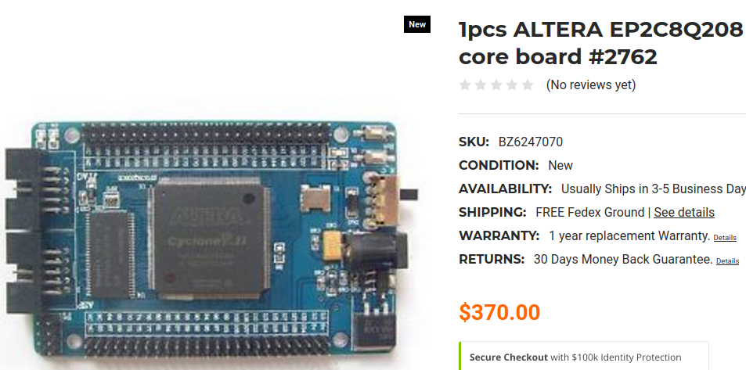
Cyclone 2 EP2C8Q208 FPGA

Slide 7
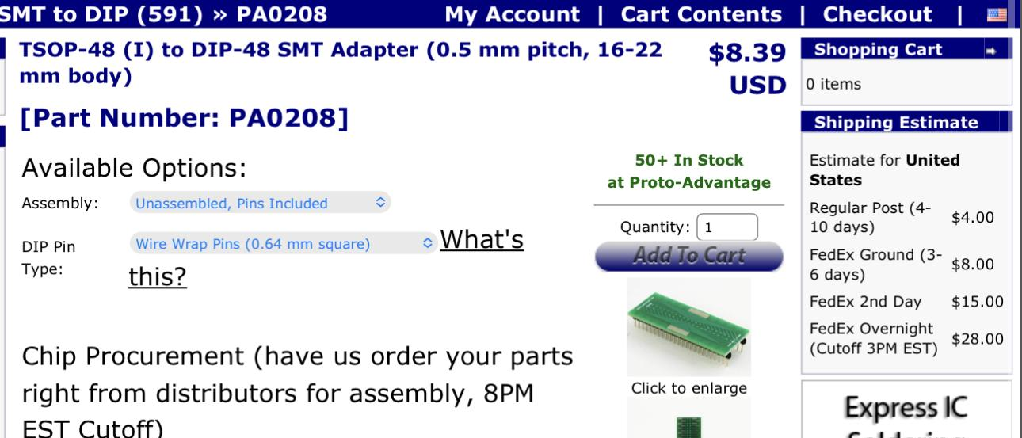
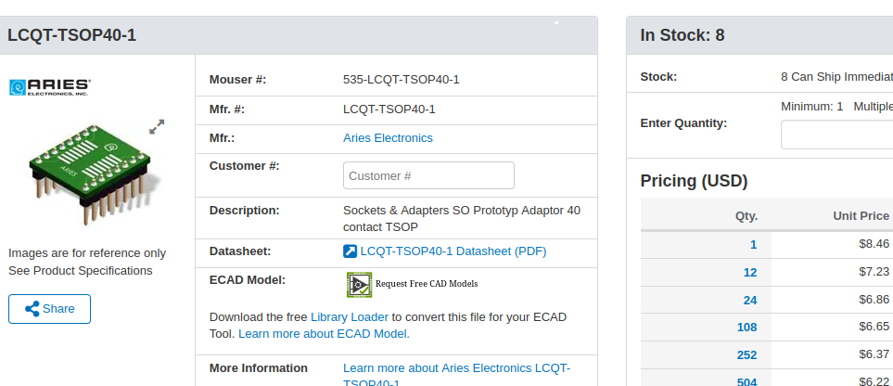
TSOP40 flash adapter

Slide 8
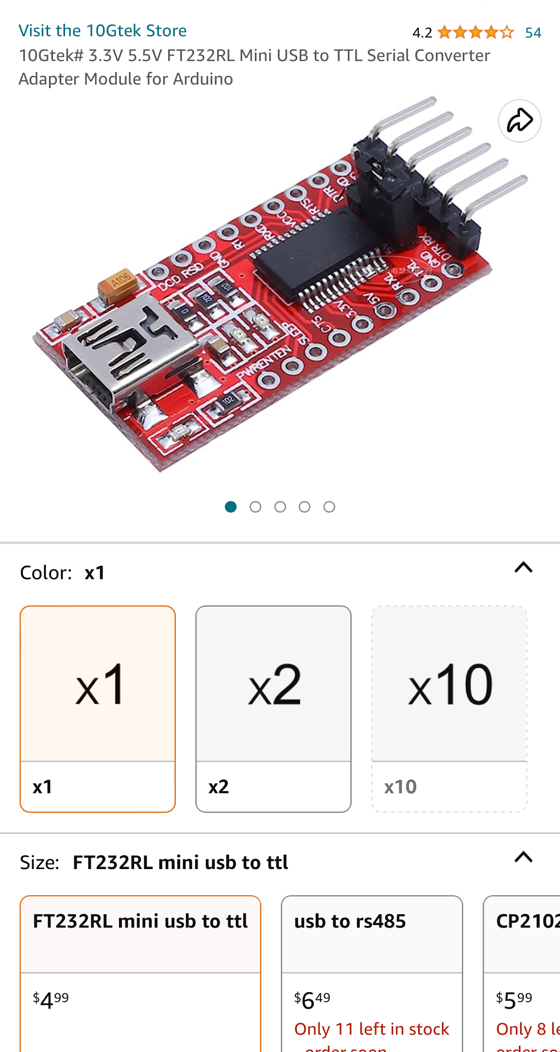
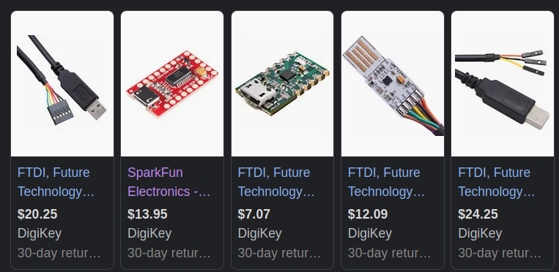
FTDI adapter

Slide 9


Cheaper Alternatives
-Cost of time over price (shipping takes forever)
-Tools made with low quality and sometimes will not function properly
-Your call to what your hardware kit should look like
-Your tools are known best by YOU!
-Knowledge

Slide 10
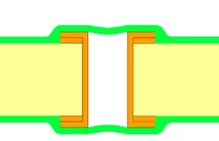
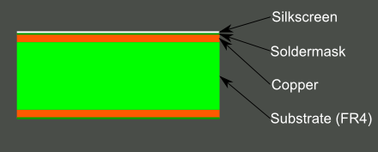
PCB…What is that? Why do I care?
-Most PCB’s are made up of fiberglass, copper traces, soldermask (color), and silkscreen (white lettering)
-Used to carry electrical signals to components to complete a task or function
-Can be reversed out using a continuity tester and copied
-Multilayer boards
VIA

Slide 11
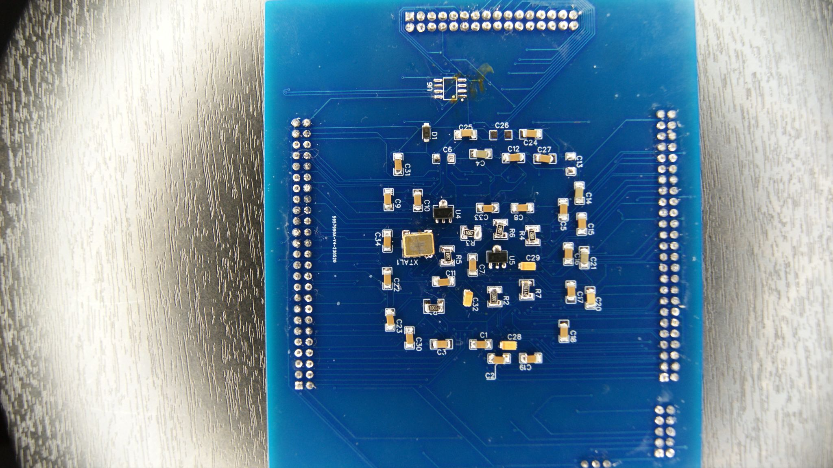
Silkscreen
Traces
VIA
SMD COMPONENTS

Slide 12
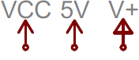

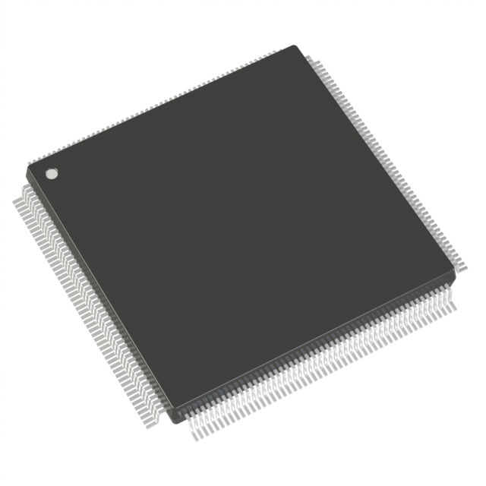
Electrical signals and power on a PCB
-Positive/Voltage (also known as VCC) IE VCC5
-Negative/Ground (also known as vss) IE GND or VSS
-Signals (protocols, data) IE spi, i2c, can, jtag, uart …etc.
-General purpose input output (GPIO)
-Refer to datasheets for proper electrical signals

Slide 13
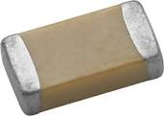
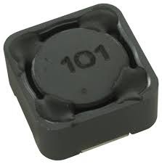
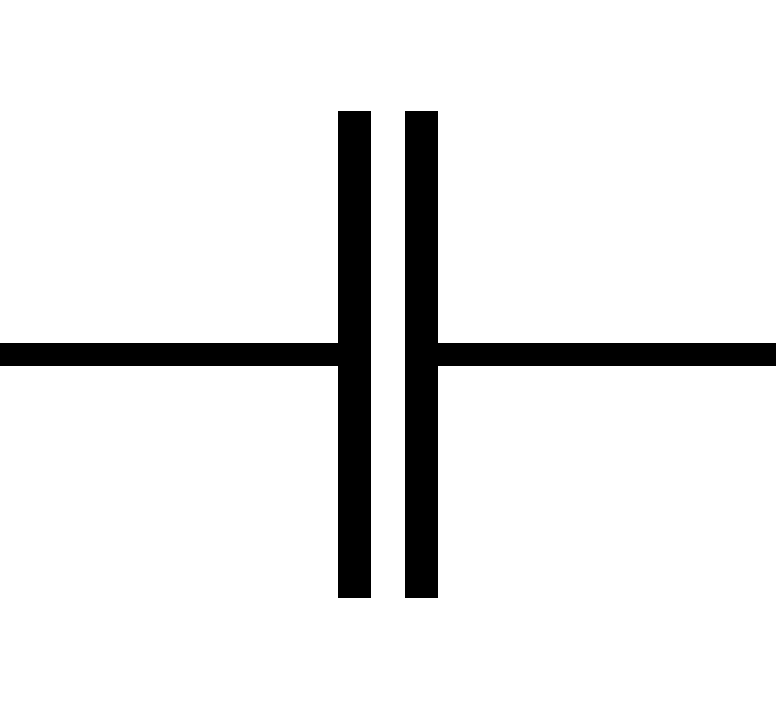
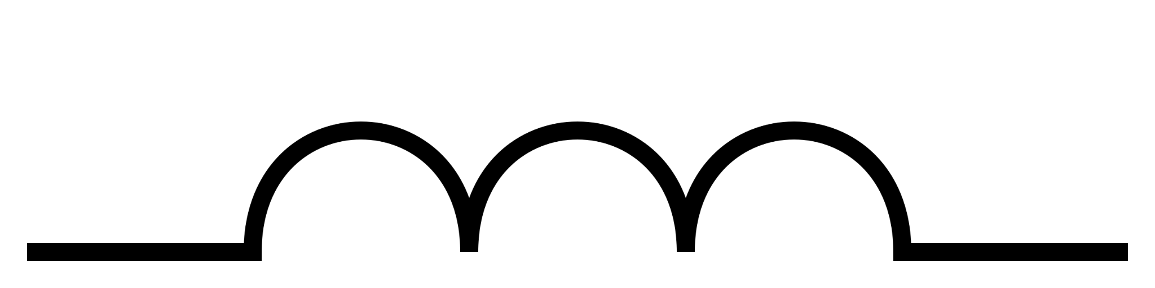
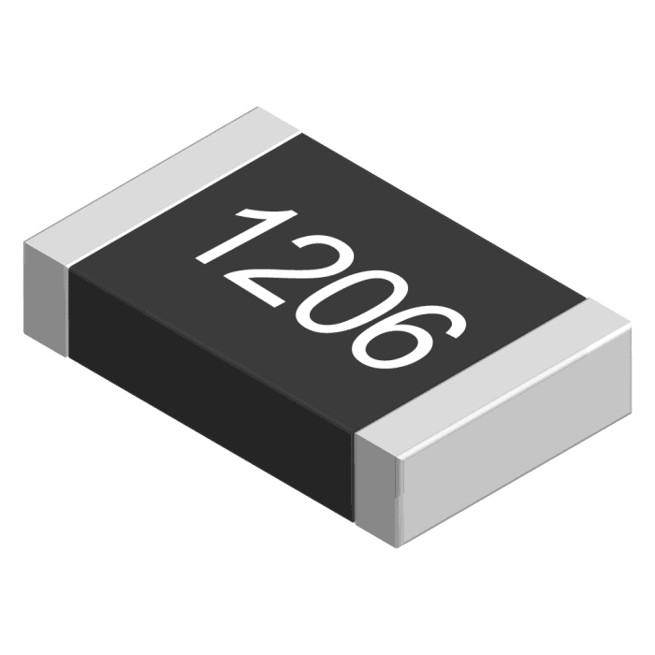
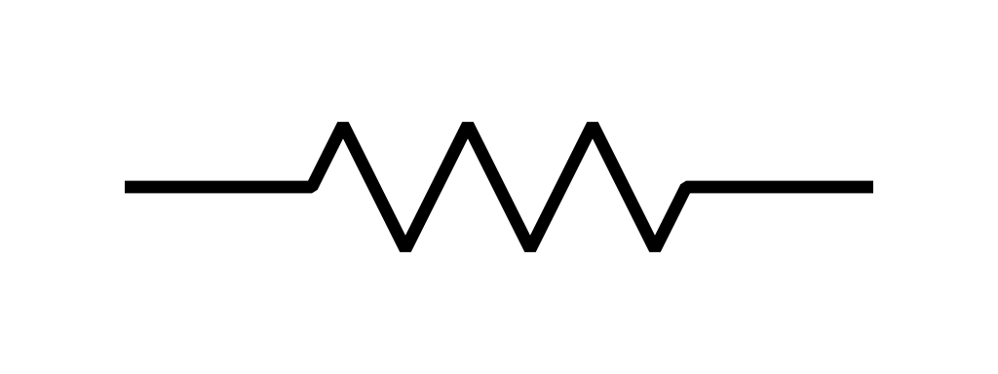
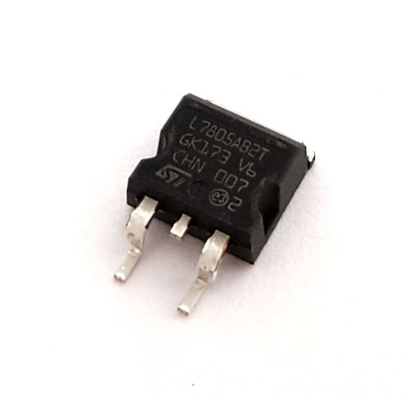
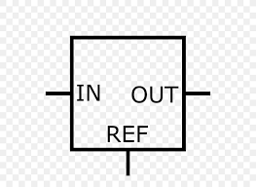
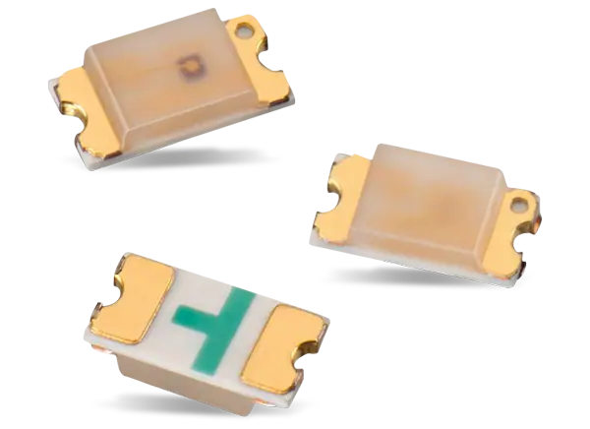
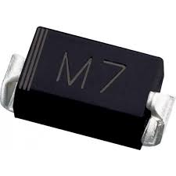
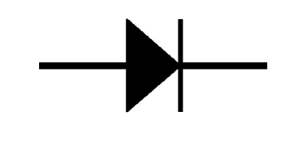
Electronics on a PCB Cont. (components - sometimes free)
Component | Purpose | Image | Symbol | Marking | Measurement
Capacitor (and inductor) | Stores energy for safe power down Reduces noise Etc | Cap. Inductor | Cap. Inductor | Cap - C Inductor - L | cap-Farad Inductor- Henry
Resistor | Reduces Voltage/current in circuit |  |  | Resistor - R | Ohm
Regulator | controls voltage in circuit |  |  | Regulator - U | Volts
Diode/LED | Forces flow of power to move in one direction |  |  | Diode - D | power

Slide 14
Electronics Cont. (Datasheets)
-Every electronic part more than likely has one (except proprietary)
-Tells you package information and ratings
-Can be found on website ordering from
-Use this as a reference to almost every electrical component you need
-Aquiring the wrong part without consulting the datasheet may cause shorts or electrical issues in the circuit. In fact it more than likely will.

Slide 15
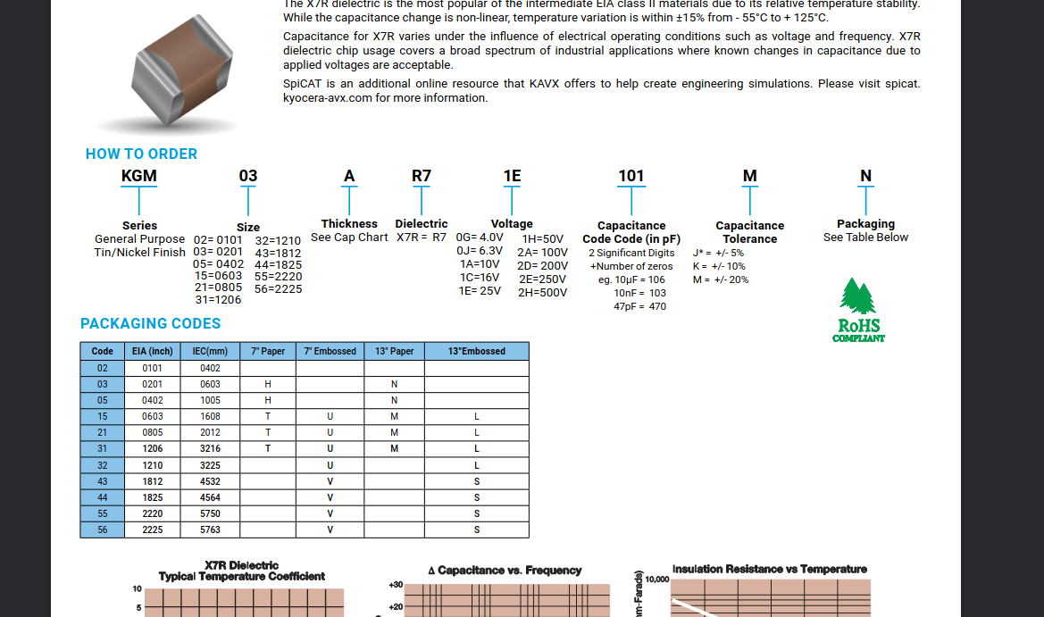

Slide 16
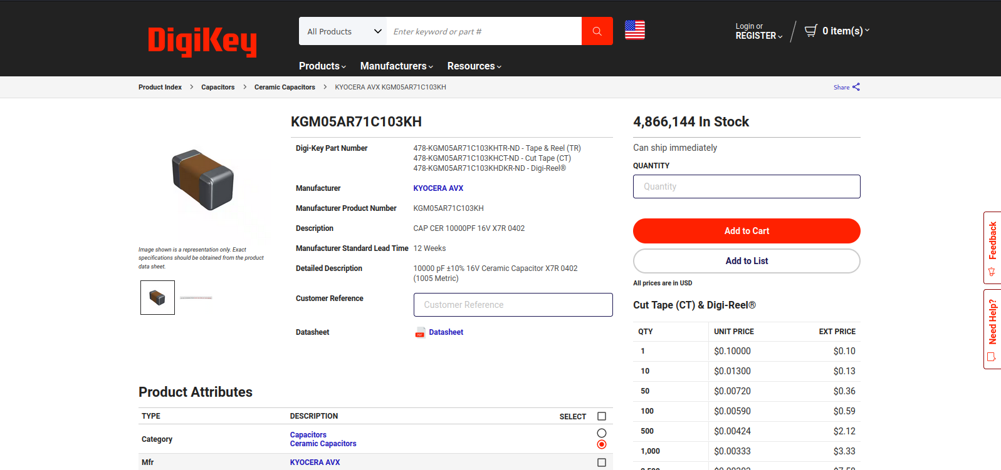

Slide 17
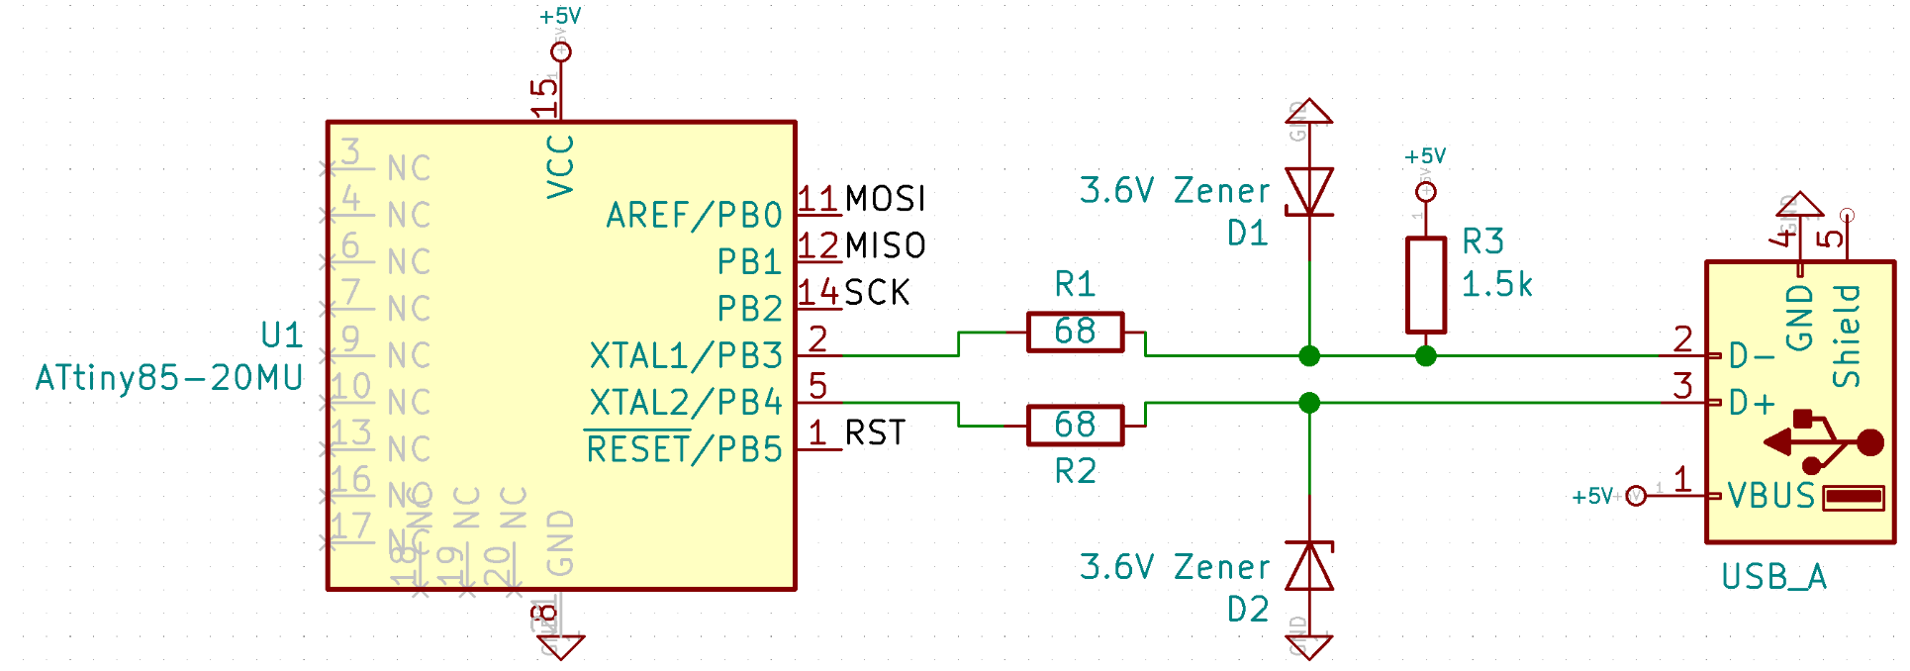
Electronics cont. (Schematic)
-Schematics are used to describe an electrical circuit
-Helps build out the printed circuit board
-Can also be reverse engineered easily
-Provide a good template to build more projects off of/add to for future tools
-Contain some description of components needed to build the circuit

Slide 18
For Informational Purposes only

Slide 19
For Informational Purposes
-Buy tool
-Switch out component that you need
-Return or sell on ebay “for parts”
-Usually account gets locked if returned or asked for replacement if found tampering
-Can become more costly and complicated
-Time efficient vs dumping firmware or ordering parts from overseas
-DO NOT DO THIS!!!

Slide 20
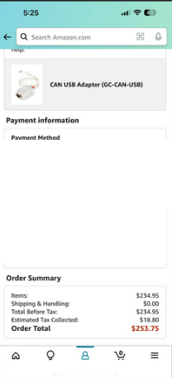
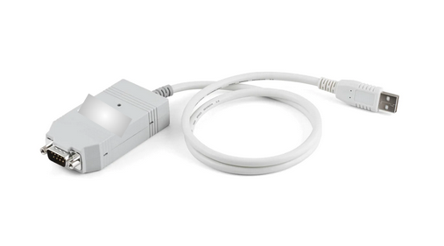
Can bus tool

Slide 21
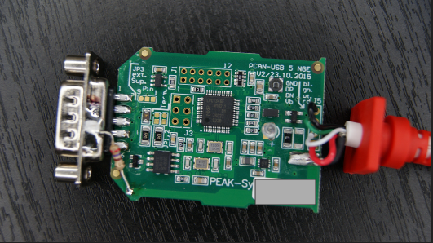
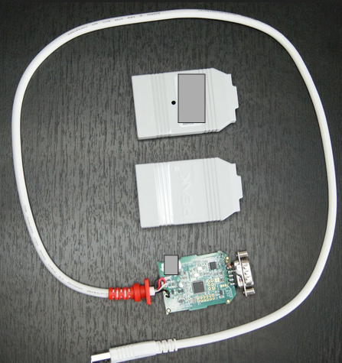
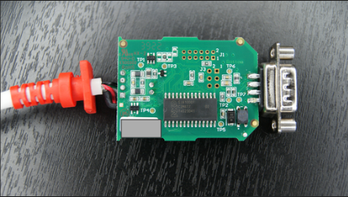
PEAK CAN Images

Slide 22
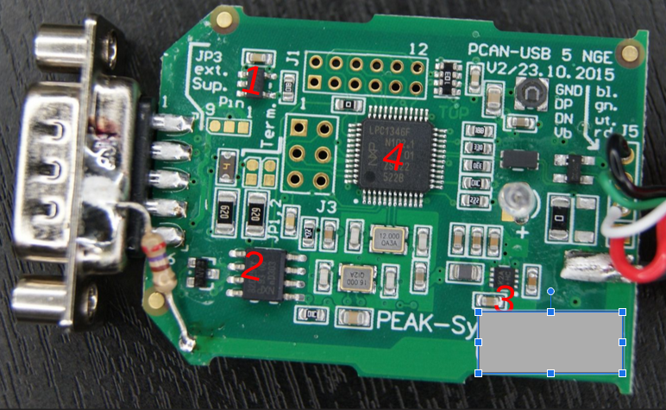
Components (front)
1
4
2
3
-Components were found online using tools
-EX https://smd.yooneed.one/

Slide 23
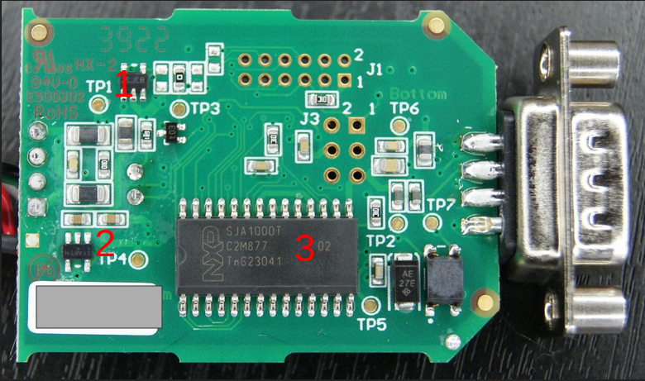
Components (back)

Slide 24
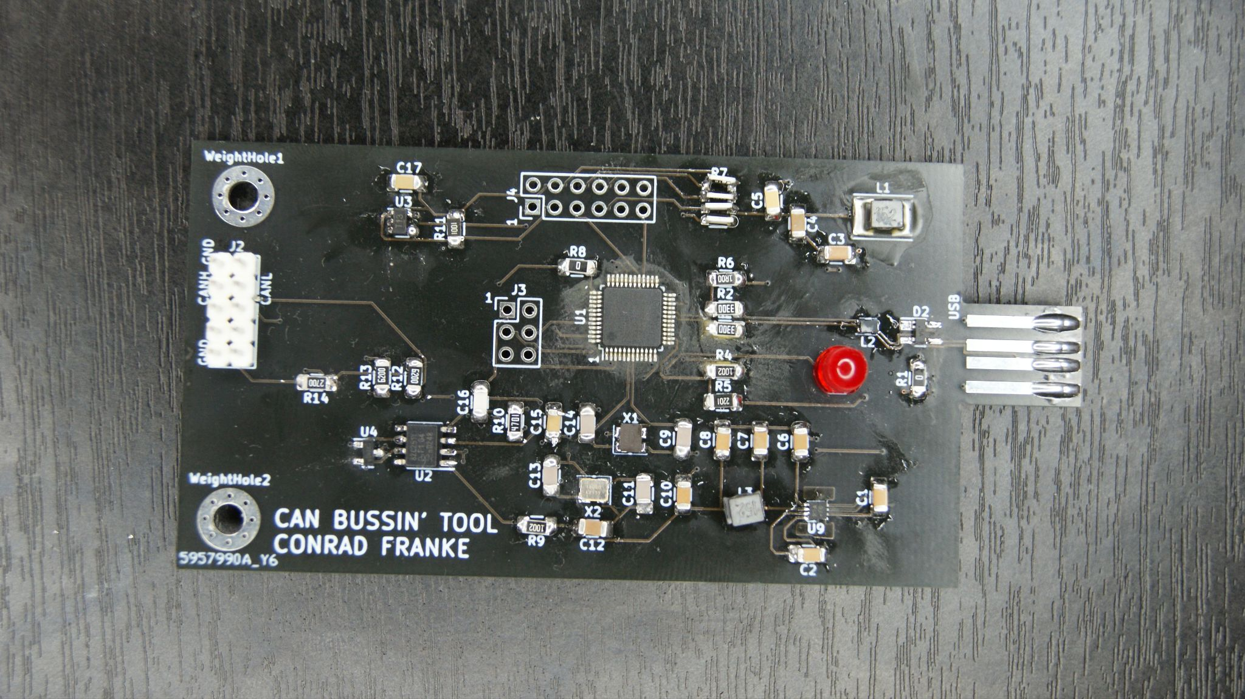
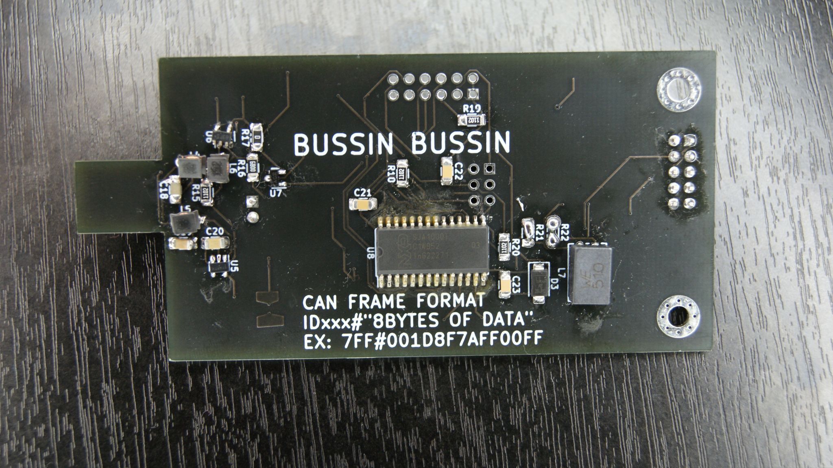
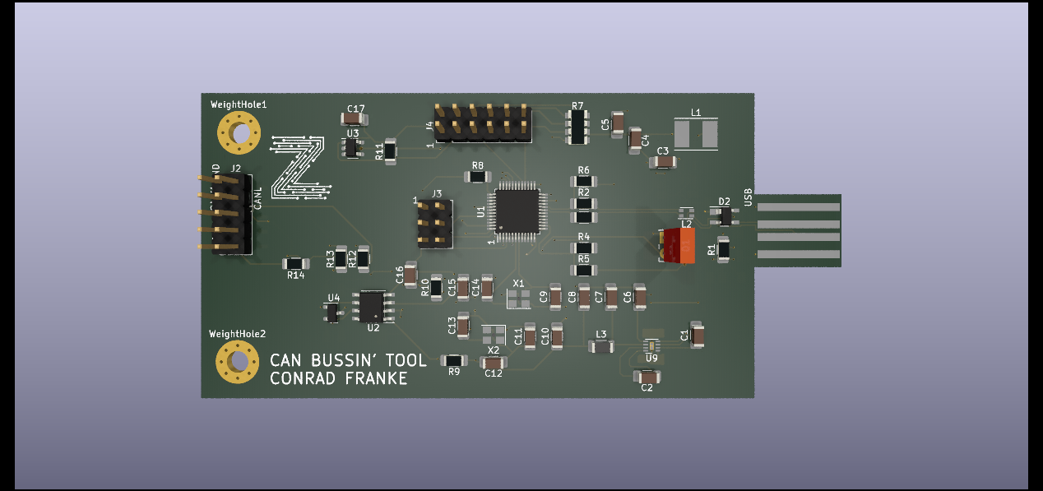
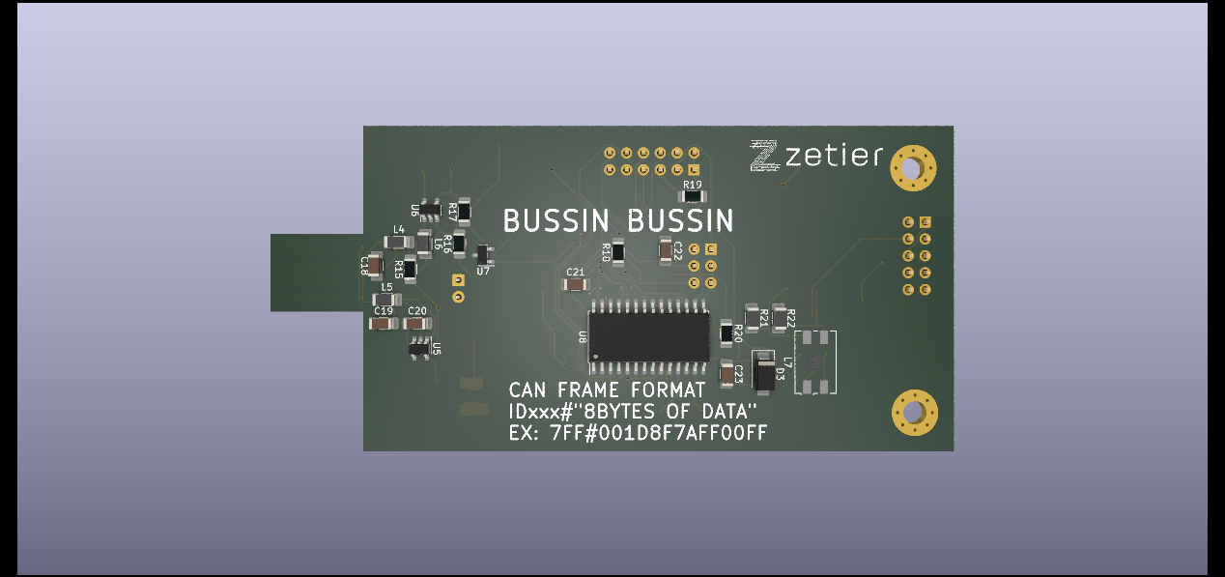
Copycats
-Took 2 weeks of freetime and extra time
-Blew a voltage regulator/replaced it
-Circuit finished
-Cost total was about 50$ in total.
-Firmware acquisition hardest part … if that path is chosen

Slide 25
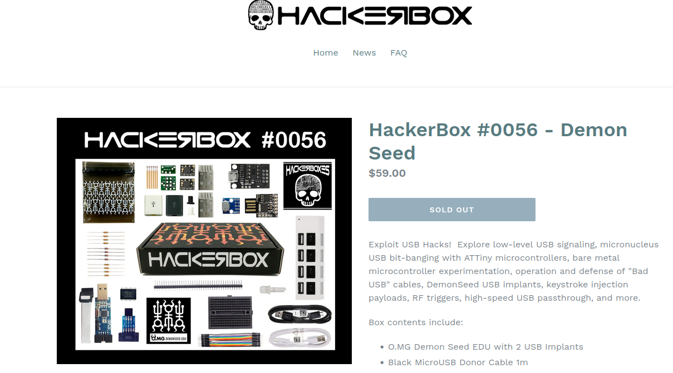
Reverse Engineering Demo

Slide 26

Kicad
-Schematic and PCB design tool
-Used to make FTDI boards from Zetier
-Used by hardware and electronic engineers to design tools and real world components
- Kicad has been used to design and fab boat controls, autonomous vehicles, radio frequency components, IOT devices and everything in between
-Lots of documentation and youtube videos
-Free

Slide 27
Kicad/FAB RE on DemonSeed

Slide 28

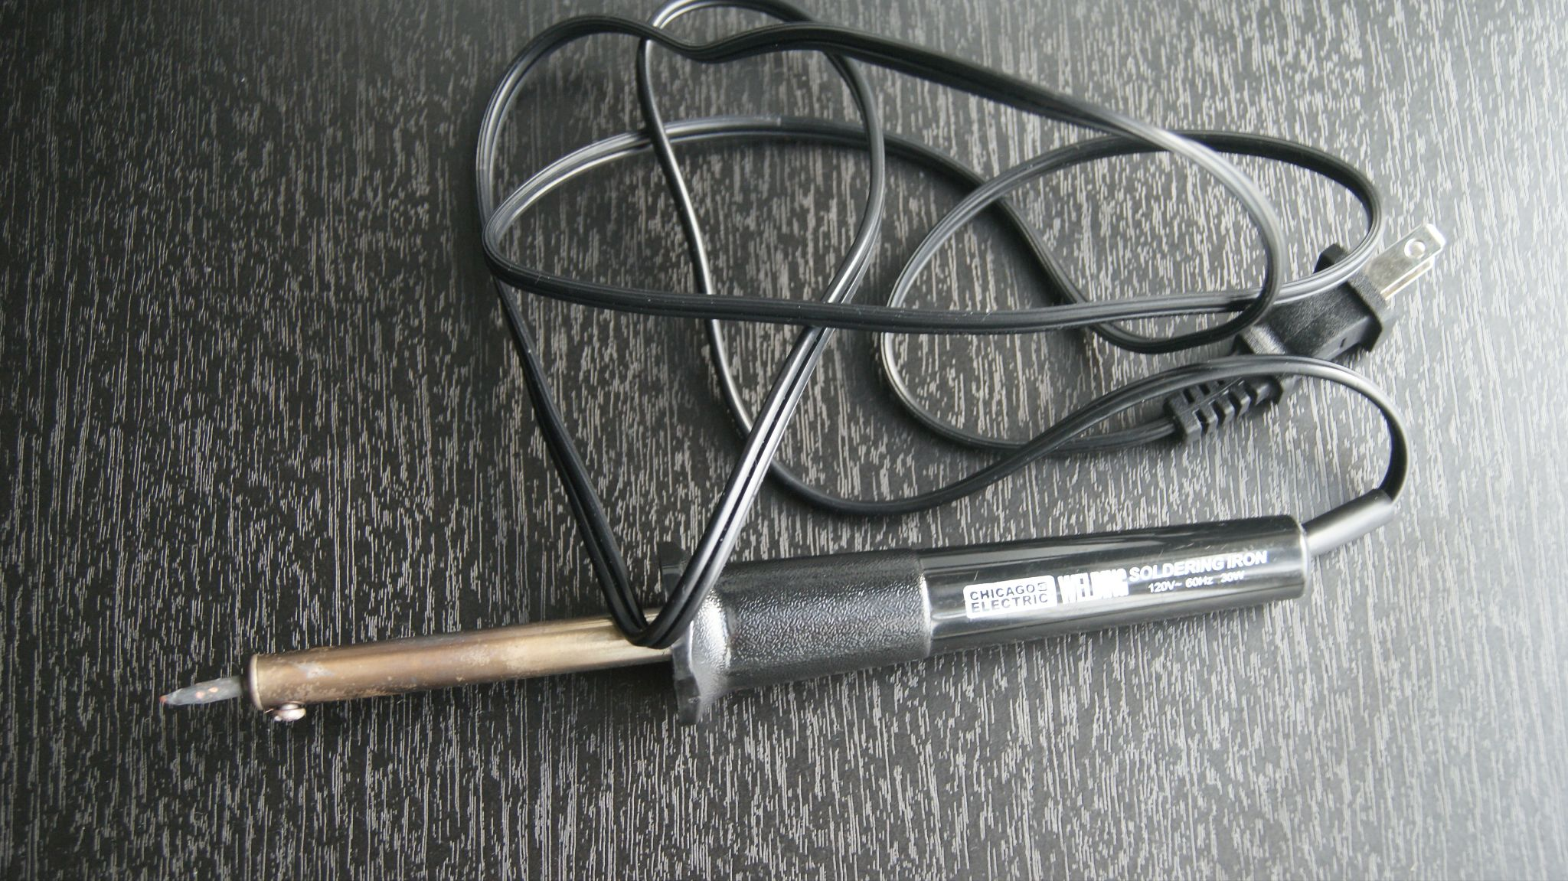
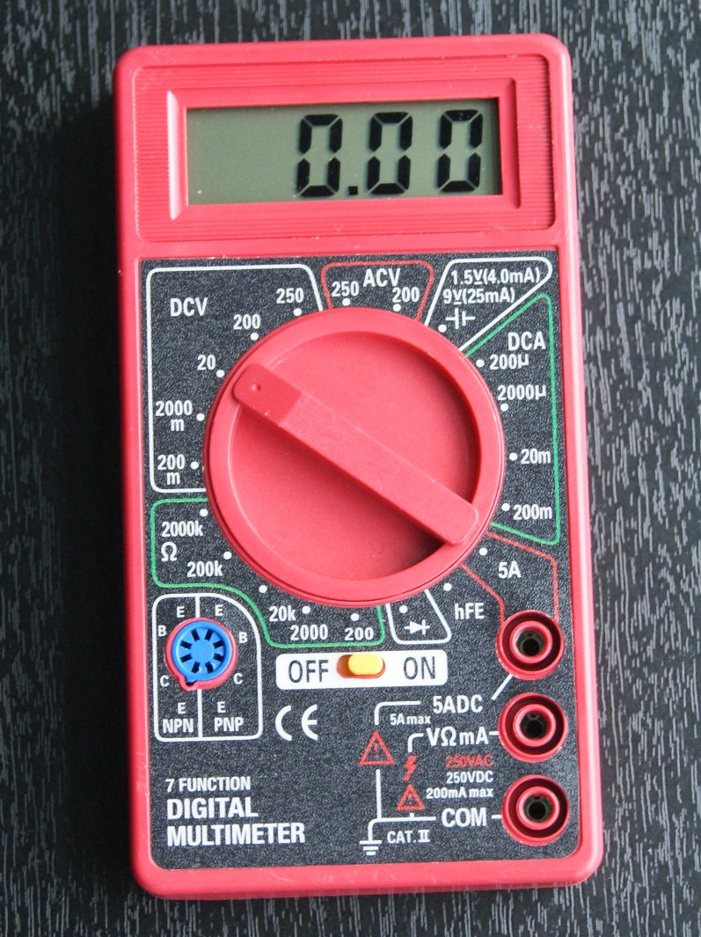
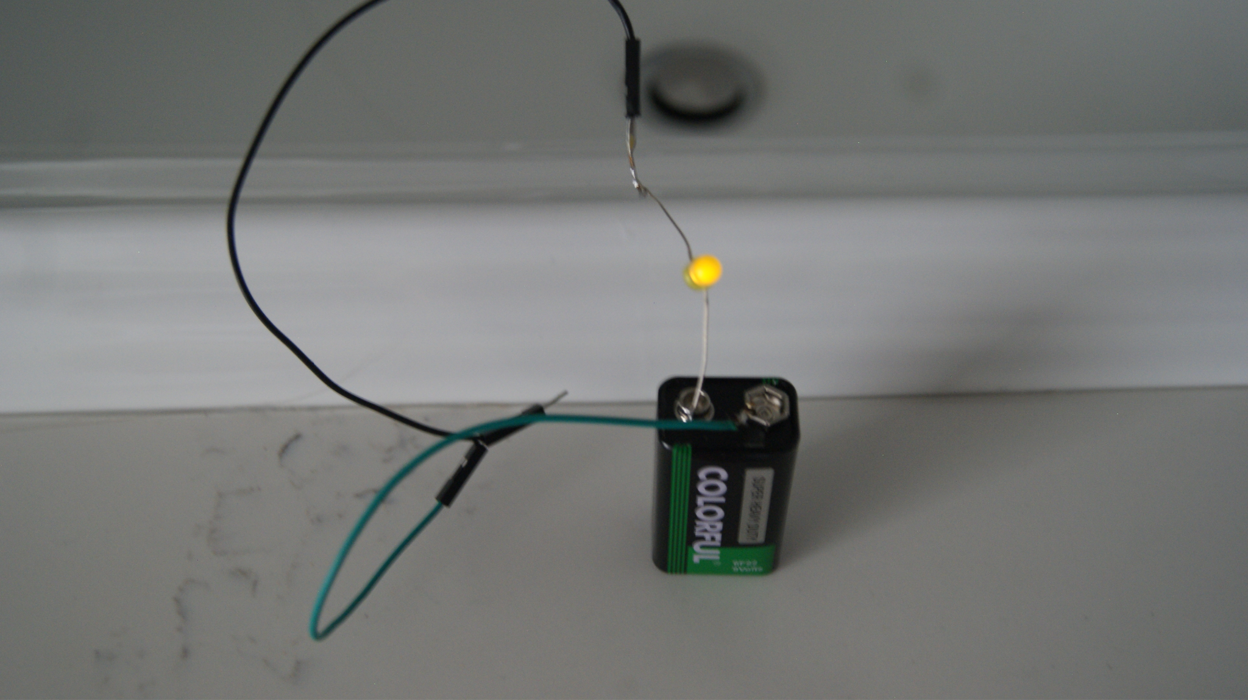
Necessary tools to start
$5⁴⁹
$6⁹⁹
Homemade Continuity tester $Free

Slide 29
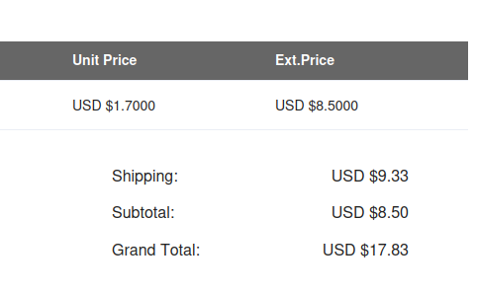
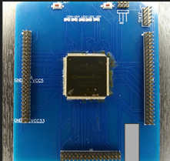
Devkit board for Cyclone 2 EP2C8Q208 FPGA
~$19 per board
-This was made with only a schematic
-No hardware was available at the time for a reasonable cost with time allotted

Slide 30
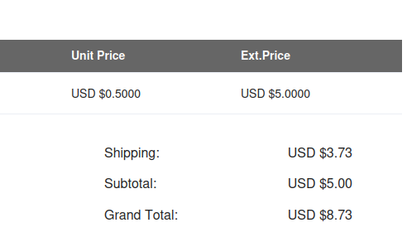
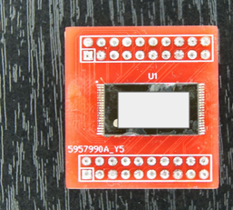
TSOP40 flash adapter
-$0.88 Per board
-Made with Kicad footprints and images of adapters available on the internet

Slide 31
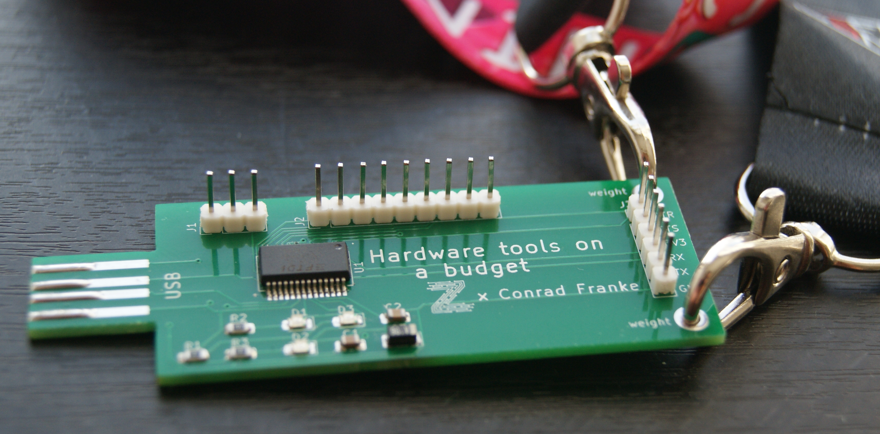
Your turn
-FTDI adapters
-Study schematic and parts / practice building your own. Don't worry about breaking it as you can order new ones using the gerbers for cents and in a pack
-Beat some of the prices you find. For an item cloned this much and available on aliexpress, it is hard to beat some prices but not impossible. Try using old components that you may have laying around in the house or in old electronics.
-include shipping with other components to save

Slide 32
Questions?

